Slide 1

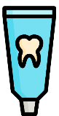
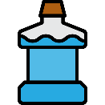
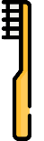
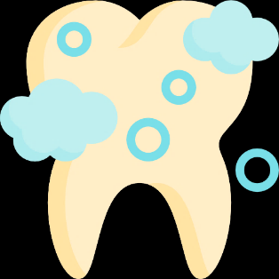
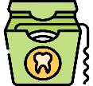
潔牙和牙線操作
資料來源：
郭念愉 口腔諮詢師
學幼童口腔保健計畫口腔保健指導員

Slide 2
潔牙原理
去除牙菌斑與食物殘渣
阻斷細菌對食物殘渣的作用
不同潔牙方式清潔的位置
方法 | 清潔位置
刷牙 | 清潔牙齒的光滑面與咬合面
牙線 | 清潔牙齒間的鄰接面
牙間刷 | 在齒縫較大時使用
Notes:
請預告下午完整的潔牙技能教學

Slide 3
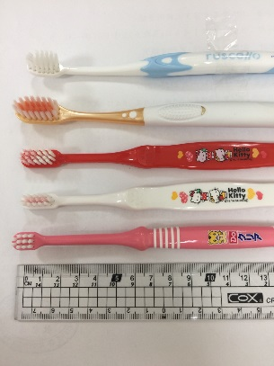
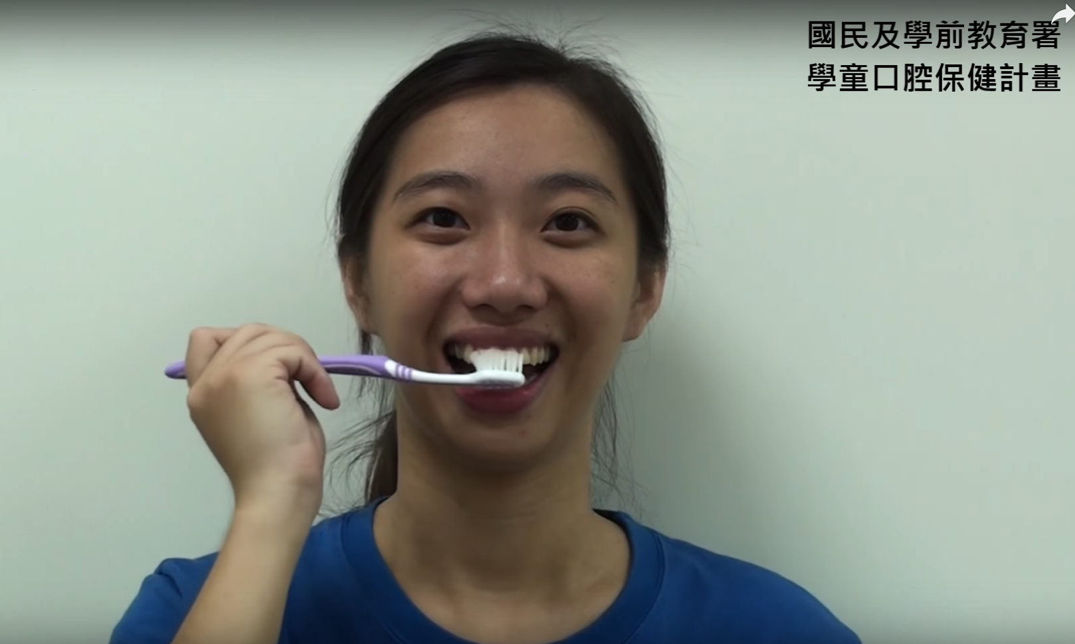

牙刷
牙刷的選擇
選用好握、刷毛軟硬適中且刷頭大小適合的
牙刷的更換
牙刷建議3-4個月更換一次，以維持清潔效果與避免細菌孳生，如刷毛有岔開應立即更換
牙刷的握法
建議採用握筆的方法，避免刷牙力道過大
Notes:
2014p.10 (Section 1): Prevention of periodontal disease – to be used in addition to caries prevention-All adults and children-Small toothbrush head, medium texture (EB=V).
2014p.18 (Section 2): brushing is more effective with a small-headed toothbrush with medium-texture bristles (ISO 20126: 2012), (V)
2014p.44 (Section 6): advise replacement of toothbrushes regularly, every one to three months.
2014p.45 (Section 6): while there is evidence that some powered toothbrushes (with a rotation, oscillation action) can be more effective for plaque control than manual tooth brushes, it is probably more important that the brush, manual or powered, is used effectively twice daily. Thorough cleaning may take at least two minutes. Brushes should have a small-head with medium-texture bristles and be changed regularly (every one to three months).

Slide 4

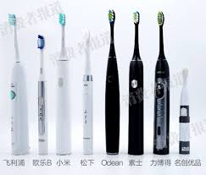
電動牙刷和手動牙刷
一些研究指出電動牙刷清潔效果可能略優於手動牙刷
刷牙最重要的仍是次數及時間，
刷牙時間充足(至少2分鐘)，清潔才能徹底
有牙周病的人建議可使用，一般民眾建議諮詢牙醫師並詳閱操作書明書之後再使用
Notes:
2014p.10 (Section 1): Use either manual or powered toothbrush (EB=I).
2014p.18 (Section 2): While there is evidence that some powered toothbrushes (with a rotation, oscillation action) can be more effective for plaque control than manual tooth brushes, probably more important is that the brush, manual or powered, is used effectively twice daily. Thorough cleaning may take at least two minutes.
2014p.45 (Section 6): while there is evidence that some powered toothbrushes (with a rotation, oscillation action) can be more effective for plaque control than manual tooth brushes, it is probably more important that the brush, manual or powered, is used effectively twice daily. Thorough cleaning may take at least two minutes. Brushes should have a small-head with medium-texture bristles and be changed regularly (every one to three months).

Slide 5
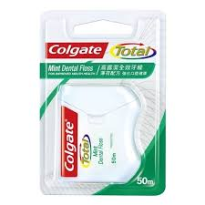
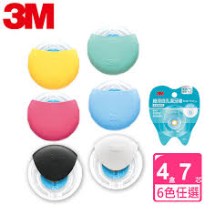
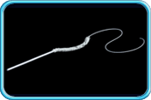
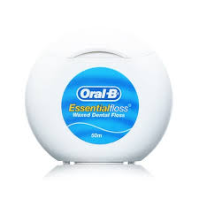
牙線
建議國小高年級學童以上者使用
清潔牙齒鄰接面
牙線依所塗的東西分成
含蠟→易放入牙缝
不含蠟→清潔效果佳
含氟→預防齲齒(但無足夠實證)
三合一牙線，用於清潔固定矯正器和固定假牙
Notes:
換牙線圖
2014p.11 (Section 1): All adults and ages 12-17: Interdental plaque control-
Clean daily between the teeth to below the gum line before toothbrushing (EB=GP✔).
For small spaces between teeth: use dental floss or tape (EB=V).
2014p.45 (Section 6): there are many types of interdental aids and personal preference will dominate choice of any individual type. However, in general, people with, or treated for, periodontitis will have larger interdental spaces due to tissue loss and interdental brushes will be more effective than dental floss or tape. The size of the interdental brush should be a snug fit in the interdental space. Therefore many patients with periodontitis will require more than one size of brush for smaller and larger spaces (e.g., between anterior and posterior teeth).

Slide 6
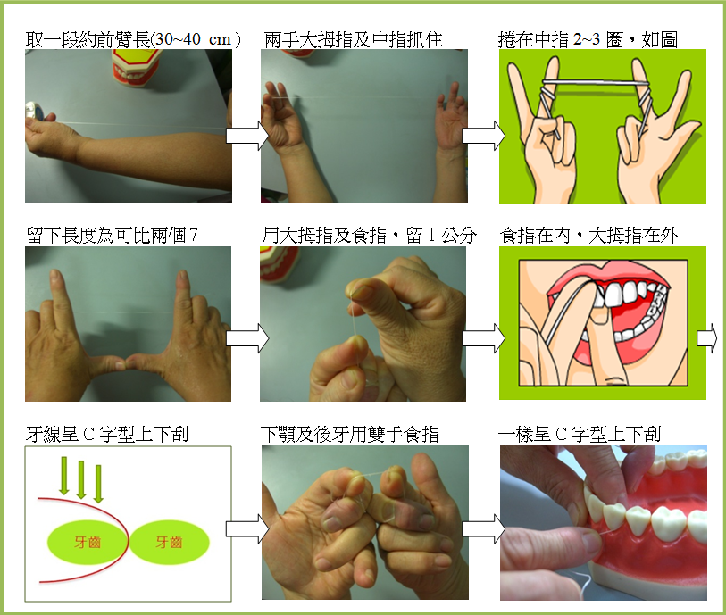
牙線的用法
(依自己的需求)

Slide 7
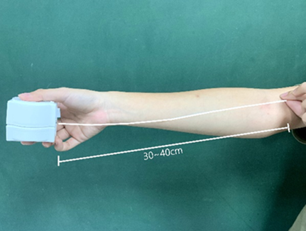
牙線的用法-(1)取牙線
(可依自己的需求)
取一段約前臂長（30～40cm）

Slide 8
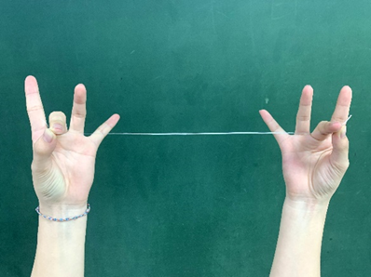
牙線的用法-(2)拿牙線
兩手以大拇指及中指抓住

Slide 9
牙線的用法-(3)捲牙線
捲在中指第一個指節
一手可以捲多一點、一手可以捲少一點

Slide 10
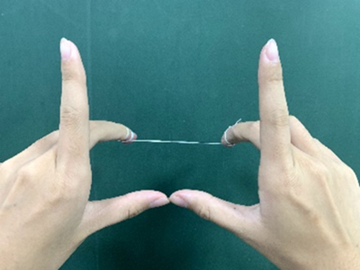
牙線的用法-(4)兩把槍
留下長度約可變成2把槍

Slide 11
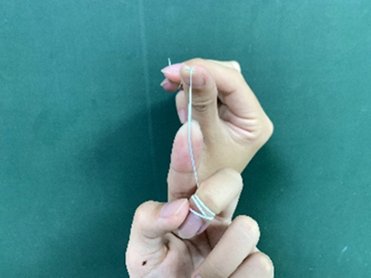
牙線的用法-(5)上面前牙手勢(犬齒到犬齒)
用大拇指及食指繃緊牙線，留1公分

Slide 12
牙線的用法-(6)滑入牙縫
食指在內，大拇指在外
不要硬塞，前後像鋸東西一樣放到牙縫中
搭配鏡子更好！

Slide 13
牙線的用法-(7)C字型
牙線呈C字型緊貼牙面上下刮
一小段就用在一個牙縫(2個面)

Slide 14
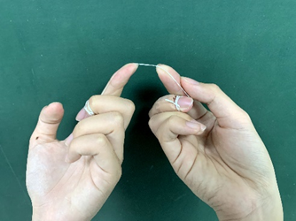
牙線的用法-(8)上面後牙、下面的牙縫手勢
用大拇指及食指繃緊牙線，留1公分

Slide 15
牙線的用法-(9)C字型
牙線呈C字型緊貼牙面上下刮
一小段就用在一個牙縫(2個面)

Slide 16
牙線的用法-(10)換牙線
放一手(原本捲比較多圈的那隻手)
收一手(原本捲比較少圈的那隻手)

Slide 17
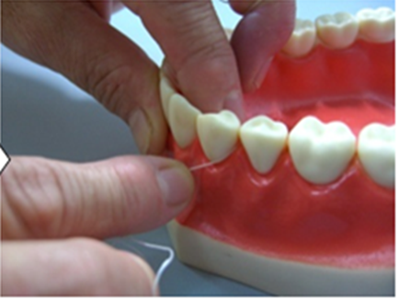
牙線用法小訣竅
-可以深入牙齒轉角處 1~2mm

Slide 18
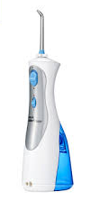
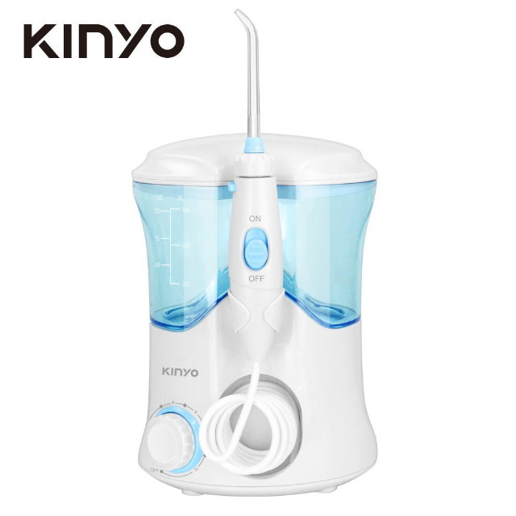
洗牙機(沖牙機)
只能沖洗大塊食物殘渣，無法取代刷牙和牙線
定位為輔助用，例如手部不方便活動的人
Notes:
2014p.10 (Section 1): Use either manual or powered toothbrush (EB=I).
2014p.18 (Section 2): While there is evidence that some powered toothbrushes (with a rotation, oscillation action) can be more effective for plaque control than manual tooth brushes, probably more important is that the brush, manual or powered, is used effectively twice daily. Thorough cleaning may take at least two minutes.
2014p.45 (Section 6): while there is evidence that some powered toothbrushes (with a rotation, oscillation action) can be more effective for plaque control than manual tooth brushes, it is probably more important that the brush, manual or powered, is used effectively twice daily. Thorough cleaning may take at least two minutes. Brushes should have a small-head with medium-texture bristles and be changed regularly (every one to three months).

Slide 19
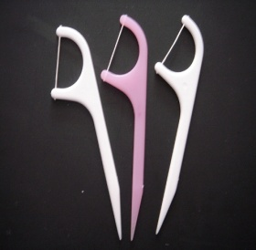
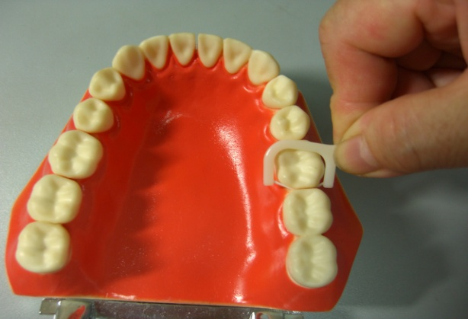
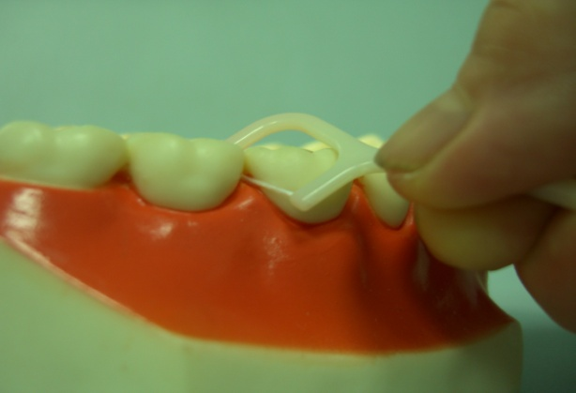
牙線棒(尚未學會使用牙線前 可替代)
由於孩童手部尚在發育且牙縫較大，可以牙線棒代替牙線
注意操作不當可能傷到牙齦
清潔效果仍以牙線較佳
慢慢放入
呈C字型上下刮

Slide 20
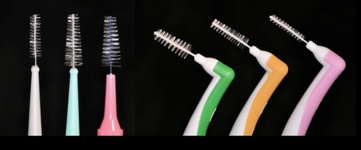
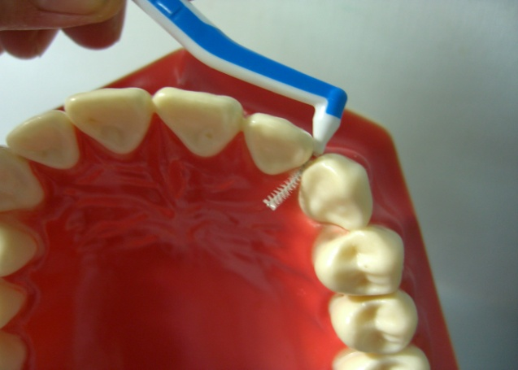
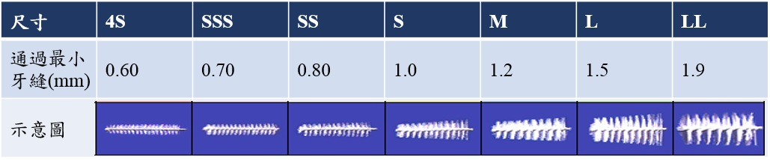
牙間刷
使用時可搭配些許牙膏
牙間刷用在清潔牙齒鄰接面牙縫較大處
個人需求選擇適合自己的尺寸，絕不能硬塞
建議1~2周更換一次
Notes:
2014p.10 (Section 1): Prevention of periodontal disease – to be used in addition to caries prevention: With extensive inflammation start with toothbrushing advice, followed by interdental plaque control (EB=GP✔).
2014p.11 (Section 1): All adults and ages 12-17: Interdental plaque control-
Clean daily between the teeth to below the gum line before toothbrushing (EB=GP✔). For small spaces between teeth: use dental floss or tape (EB=V). For larger spaces: use interdental or single-tufted brushes (EB=V). Around orthodontic appliances and bridges: use kit suggested by the dental professional (EB=V). Professional intervention: Assess patient’s preferences for interdental plaque control: Decide on appropriate interdental kit. Demonstrate methods and types of kit. Assess plaque removal abilities and confidence with kit. Patient sets target for interdental plaque control.
2014p.44 (Section 6): Oral hygiene – dental plaque control for periodontal health: encourage daily interdental cleaning before toothbrushing. Since toothbrushing but not interdental cleaning is a routine for the majority of people, carrying out interdental oral hygiene first may link these activities and help develop regularity.
2014p.45 (Section 6): there are many types of interdental aids and personal preference will dominate choice of any individual type. However, in general, people with, or treated for, periodontitis will have larger interdental spaces due to tissue loss and interdental brushes will be more effective than dental floss or tape. The size of the interdental brush should be a snug fit in the interdental space. Therefore many patients with periodontitis will require more than one size of brush for smaller and larger spaces (e.g., between anterior and posterior teeth).

Slide 21
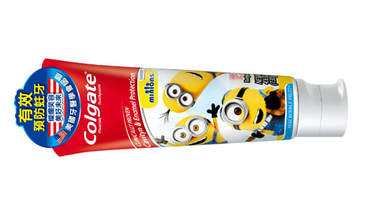
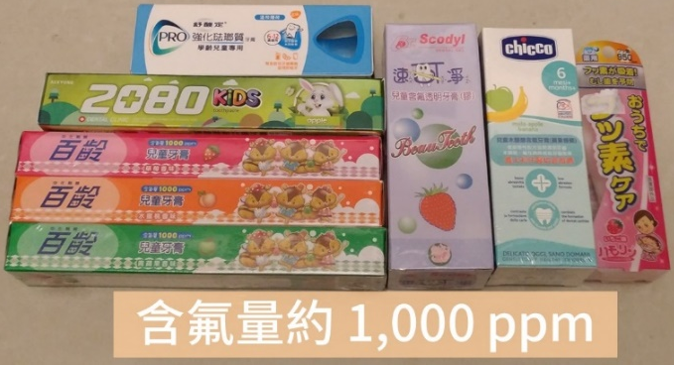
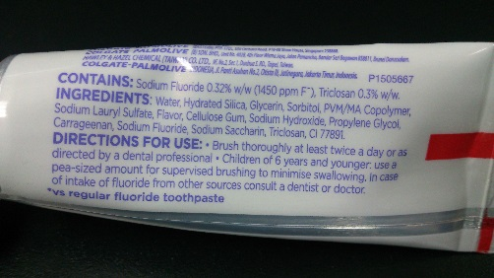
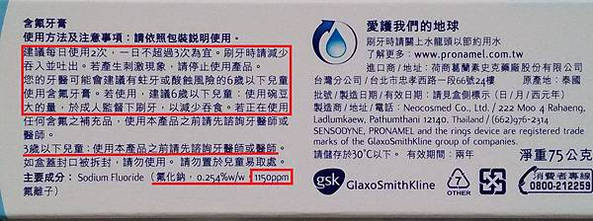
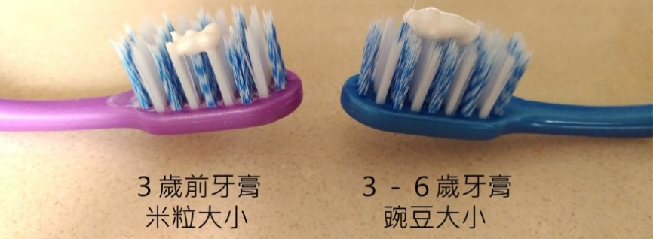
含氟牙膏
氟化物(Fluoride)降低齲齒原理
促進牙齒的再礦化，改善琺瑯質結構與對抗酸的作用
可以抑制牙菌斑的形成
可以抑制細菌分解醣類，進而抑制細菌孳生
含氟量選擇
Sodium Fluoride 1450ppm F
對象 | 含氟量 | 用量
未滿3歲孩童 | 1000 ppm
3-6歲孩童 | 1000 ppm
7歲以上孩童 | 1000-1500 ppm
成人 | 1000 ppm 以上
薄薄一層(米粒大小)
碗豆大小
碗豆大小
圖片來源：http://luycpedodentist.blogspot.tw/2017/03/child-toothpaste.html
http://luycpedodentist.blogspot.tw/2018/01/ChildrenToothpaste.html
碗豆大小
Notes:
2014p.6 (Section 1): Prevention of caries in children age 0-6 yrs: Children aged up to 3 years: Use fluoridated toothpaste containing no less than 1,000 ppm fluoride (EB=I).
It is good practice to use only a smear of toothpaste (EB=GP✔).
2014p.7 (Section 1): Prevention of caries in children age 0-6 yrs: All children aged 3-6 years: Use fluoridated toothpaste containing more than 1,000 ppm fluoride (EB=I).
It is good practice to use only a pea size amount (EB=GP✔).
Children aged 0-6 giving concern (e.g., those likely to develop caries, those with special needs): Use fluoridated toothpaste containing 1,350-1,500 ppm fluoride (EB=I).
2014p.8 (Section 1): Prevention of caries in children aged from 7 years and young adults. Use fluoridated toothpaste (1,350-1,500 ppm fluoride)(EB=I).
2014p.9 (Section 1): Prevention of caries in adults-Use fluoridated toothpaste with at least 1350 ppm fluoride (EB=I).
2014p.10 (Section 1): Prevention of periodontal disease – to be used in addition to caries prevention-All adults and children-Toothbrushing and toothpaste
Brush gum line AND each tooth twice daily (before bed and at least on one other occasion). For further information regarding toothpastes and periodontal health see section 6.1 (EB=V).
2014p.17 (Section 2): The major dental conditions of caries and periodontal disease can both be reduced by regular toothbrushing with fluoride toothpaste. To control caries it is the fluoride in toothpaste which is the important element of toothbrushing, as fluoride serves to prevent, control and arrest caries. Higher concentration of fluoride in toothpaste leads to better caries control. Some toothpastes contain ingredients which also reduce plaque, gingivitis and bleeding gums. Children under three years should use a toothpaste containing no less than 1,000 ppm fluoride. Children under three years should use no more than a smear of toothpaste (a thin film of paste covering less than three-quarters of the brush) and must not be permitted to eat or lick toothpaste from the tube. Family fluoride toothpaste (1,350-1,500 ppm) is indicated for maximum caries control for all children except those who cannot be prevented from eating toothpaste. Advice must be given about adult supervision and the small amounts to be used.
2014p.17 (Section 2): Children need to be helped or supervised by an adult when brushing until at least seven years of age and must not be permitted to eat or lick toothpaste from the tube. Since then fluoride has become more widely available, most notably in toothpaste and is widely recognised as having improved oral health in the UK.
2014p.19 (Section 3): Fluoride toothpaste-Strong evidence shows that toothpastes containing higher concentrations of fluoride are more effective at controlling caries. It is clear that low fluoride toothpastes (those containing less than 1,000 ppm) are ineffective at controlling caries.
2014p.20 (Section 3): The review concluded that the evidence about the risk of fluorosis from starting the use of fluoride toothpaste in children under 12 months of age was weak, and for starting between the age of 12 and 24 months was equivocal. It also stated that where the risk of fluorosis is of particular concern, the fluoride level of toothpaste for young children is recommended to be lower than 1,000ppm. However, for children considered to be at high risk of tooth decay by their dentist, the benefit to health of preventing decay may outweigh the risk of fluorosis. In such circumstances, careful brushing by parents/carers with toothpastes containing higher levels of fluoride would be beneficial. The risk of fluorosis from ingesting too much fluoride are linked much more to the amount of toothpaste that is used, than to the concentration. Risks of aesthetically challenging fluorosis to permanent incisors are relevant only to ingestion of fluoride by those under three years old. Calcification of the crowns of these teeth is complete by 30 months. Risks of aesthetically challenging fluorosis to premolars are only relevant to those aged under six years as calcification of the crowns of these teeth is complete by this age. A research study investigated the concentration and amount of toothpaste used by children aged one to two years. This showed that the ingestion of fluoride among children who used a large amount of paste could be as much as twenty times higher than that for children who used only a small amount. In contrast there was only a four fold difference in the amount of fluoride ingested between those who used a low fluoride toothpaste and those using one containing 1,450 ppm. See figure 3.1. Putting these pieces of evidence together shows that the best combination is to use higher concentration toothpaste in very small quantities for children aged six years and below. For this reason parents should be shown how small an amount to use and they should ensure their children do not eat or lick the toothpaste.
2014p.70 (Section 6): Professional action for high risk patients. use toothpaste containing at least 1,450 ppm twice daily (Lussi et al., 2006).

Slide 22
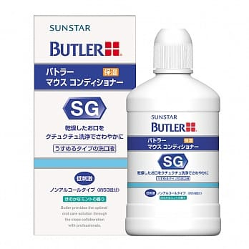
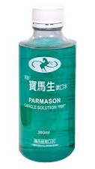
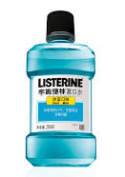

漱口水
主要只是強化作用，不能代替刷牙的功能
口內有傷口建議選不含酒精的，並依照指示使用
8歲以上孩童建議每日使用一次含氟漱口水(0.05%)，
且與含氟牙膏的使用間隔30分鐘，以達最大效益
牙科含chlorhexidine的漱口水，主要是短期使用來控制牙菌斑，如長期使用可能會造成口腔內正常菌群失調，且有可能造成假牙色素沉澱或味覺感變差
Notes:
一般不建議六歲以下的孩童使用含氟漱口水(ref=?)
2014p.8 (Section 1): Prevention of caries in children aged from 7 years and young adults-Those giving concern to their dentist-(eg, those with obvious current active caries, those with ortho appliances, dry mouth, other predisposing factors, those with special needs)-Use a flu(oride mouth rinse daily (0.05% NaF-) at a different time to brushing(EB=I). Professional intervention: For those 8 years upwards with active caries prescribe daily fluoride rinse (EB=I).
2014p.9 (Section 1): Prevention of caries in adults-Those giving concern to their dentist (eg. with obvious current active caries, dry mouth, other predisposing factors, those with special needs: Use a fluoride mouthrinse daily (0.05% NaF-) at a different time to brushing (EB=I). Professional intervention: For those with active coronal or root caries prescribe daily fluoride rinse (EB=I).
2014p.18 (Section 2): rinsing with water, mouthwashes or mouth rinses (including fluoride rinses) immediately after toothbrushing will wash away the concentrated fluoride in the remaining toothpaste, thus diluting it and reducing its preventive effects. For this reason rinsing after toothbrushing should be discouraged.
2014p.19: (Section 3): Milk fluoridation: There are a few schemes in England which supply children with fluoridated milk at school. They are provided in areas which are not fluoridated and where levels of caries are high. Children should not take part if they have fluoride tablets or fluoride rinse on a daily basis.
2014p.30-31 (Section 3): Use of additional fluoride-Fluoride rinses: These can be prescribed for patients aged eight years and above, for daily use, in addition to twice daily brushing with toothpaste containing at least 1,350ppm fluoride. Rinses require patient compliance and should be used at a different time to toothbrushing to maximize the topical effect, which relates to frequency of availability. Rinsing, even with a fluoride rinse immediately after brushing will reduce the beneficial effects of fluoride toothpaste. Fluoride in toothpaste (1,000-1,500 ppm) is at a higher concentration compared with fluoride rinses (225 ppm) and so is more effective if retained in the mouth, rather than being diluted or washed away by rinses.
2014p.46 (Section 6): 3. Managing risk factors-Medications-Action: oral hygiene – consider short-term use of chlorhexidine mouthrinse in addition to usual plaque control.

Slide 23
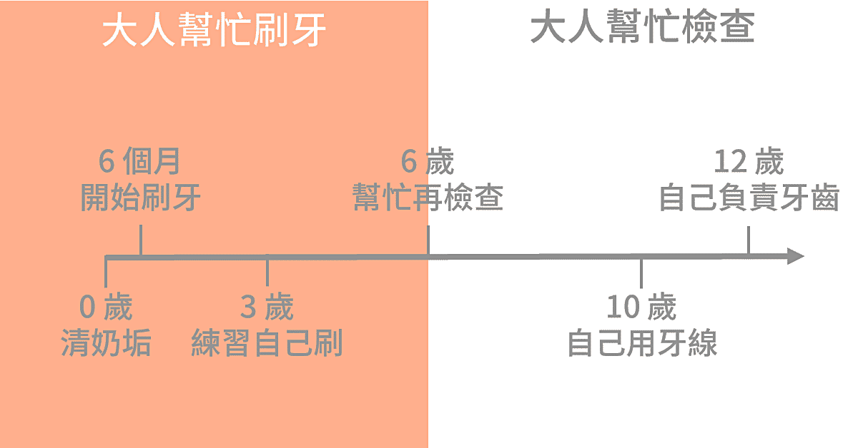
各階段刷牙協助
圖片來源：http://luycpedodentist.blogspot.tw/2017/09/ToothbrushAndAge.html

Slide 24
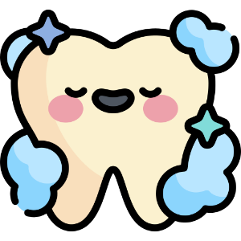

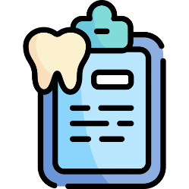
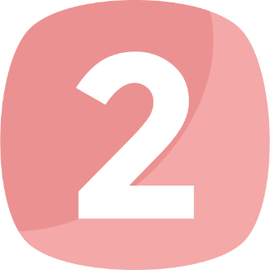
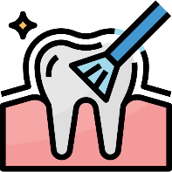


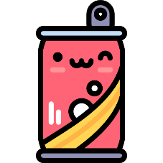
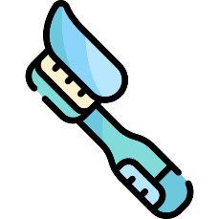



學幼童齲齒預防方法
照護者協助鄰接面清潔
照護者再次清潔與檢查
定期牙科檢查與塗氟
每天至少刷牙2次
睡前潔牙最重要
One more time
含糖的食用頻率與攝取量影響
一樣重要
刷牙搭配
含氟量1000ppm牙膏

Slide 25
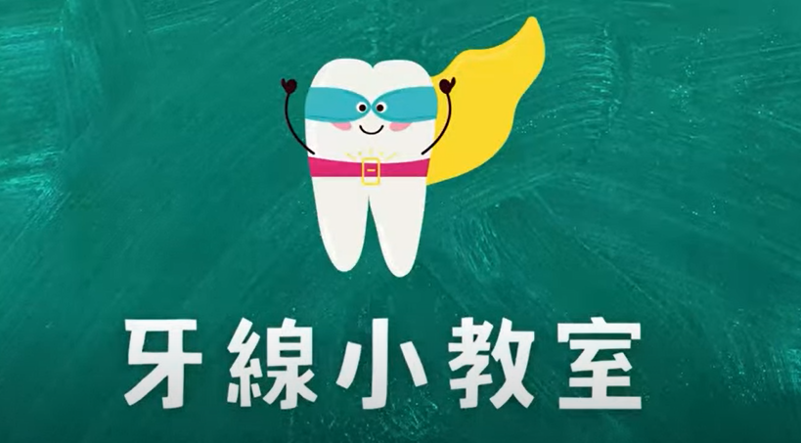
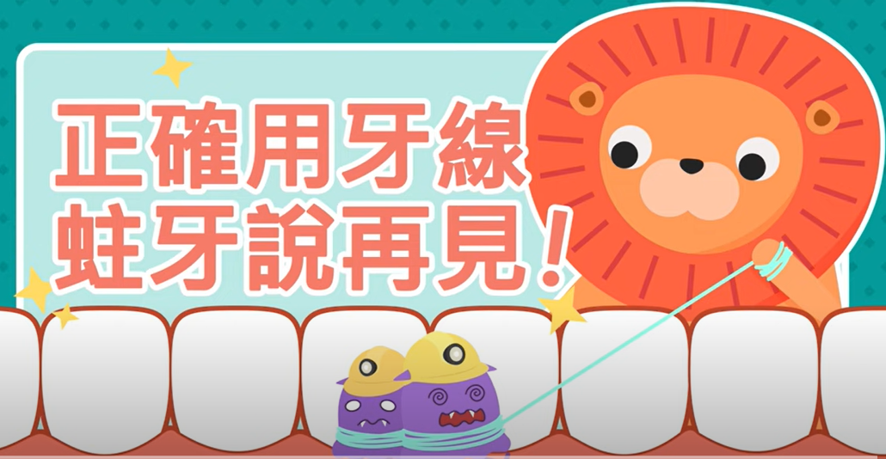
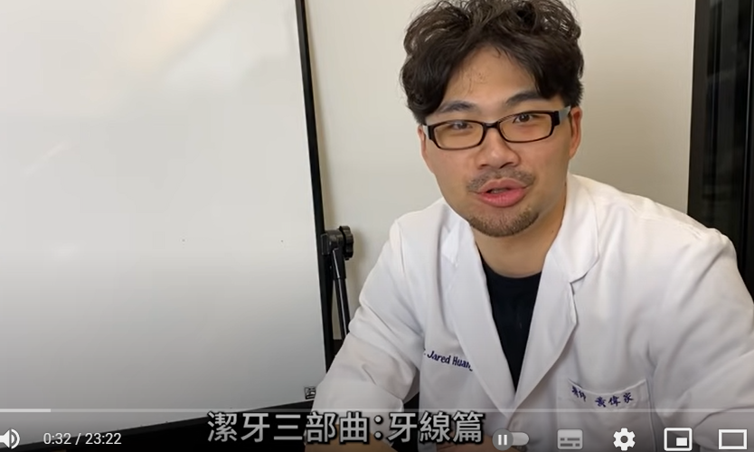
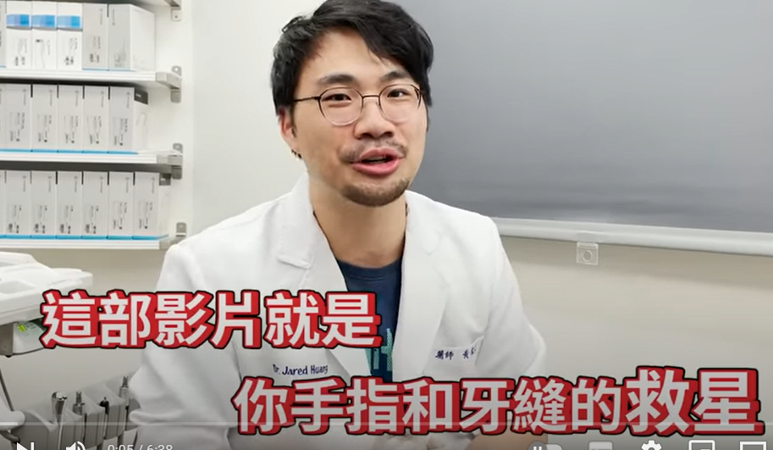
牙線操作方法影片

